Slide 1


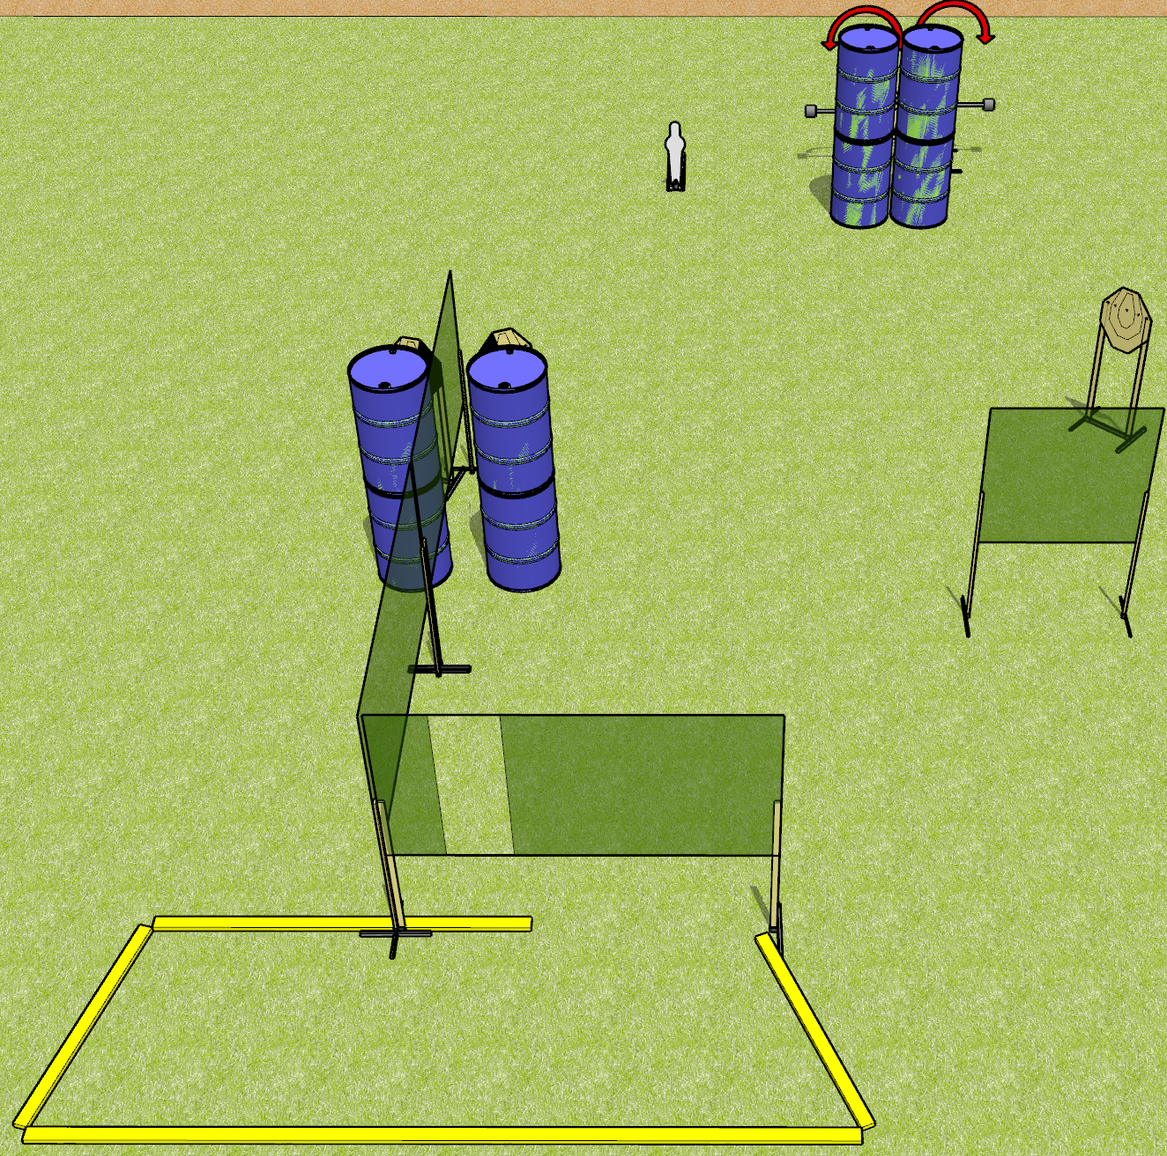
 | Dothan Gun Club – USPSA Match Lean and Mean Course Designer : Drew Coleman
Round Count 11 rounds 5 IPSC targets 1 mini popper
Equipment List 6 wall feet 2 medium fault lines 2 swingers + activators 1 left + 1 right dia, 3 targets

Slide 2
Lean and Mean
Written Stage Briefing
Lean and Mean is an 11 round, 55 point, Comstock course of fire. There are 5 IPSC targets and 1 mini popper. The best 2 hits on paper will score, and steel must fall to score. The start signal is audible.
The swingers are activated by the mini popper and remain visible at rest.
Handgun start position is inside the shooting area, wrists below belt. Handgun is loaded and holstered.
PCC start position is inside the shooting area, stock on belt. Loaded carbine is held with both hands, safety on.
On start signal, engage targets as they become available from within the shooting area.

Slide 3
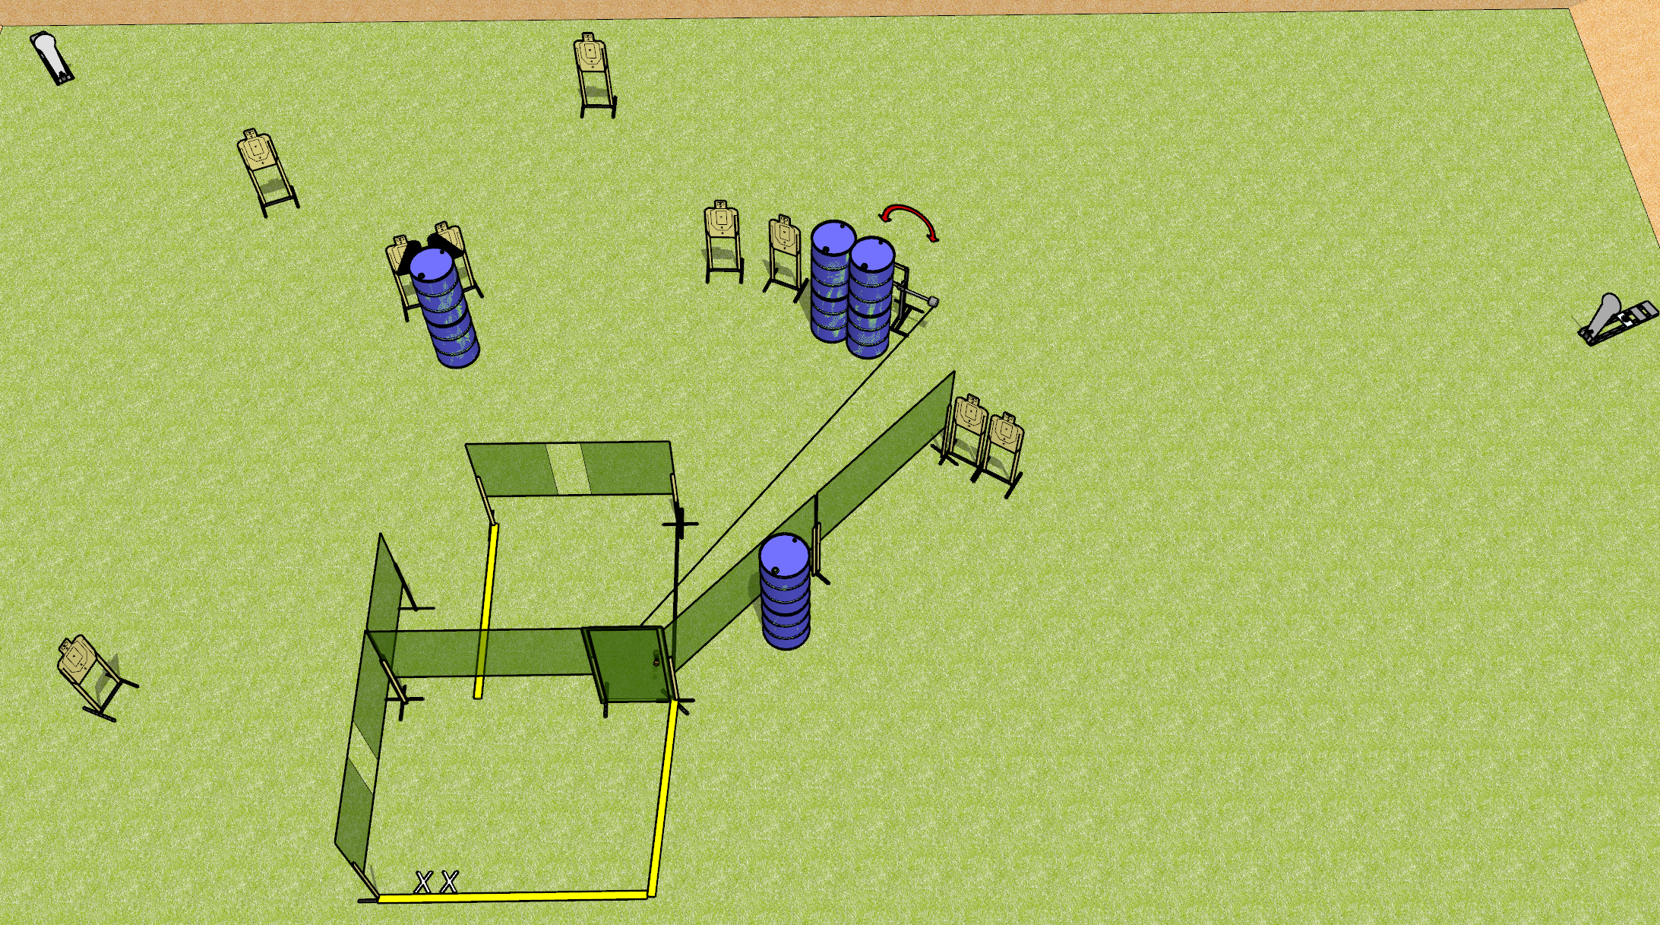
 | Dothan Gun Club – USPSA Match Out the Door Course Designer : Drew Coleman
Round Count 22 rounds 10 USPSA 2 colt poppers
Equipment List 11 wall feet Swinger + activator to door 1 left + 1 right diag, 8 targets

Slide 4
Out the Door
Written Stage Briefing
Out the Door is a 22 round, 110 point, Comstock course of fire. There are 10 USPSA targets and 2 colt poppers. The best 2 hits on paper will score, and steel must fall to score. The start signal is audible.
The swinger is activated by the door and remains visible at rest.
Handgun start position is feet on X’s, wrists above shoulders. Handgun is loaded and holstered.
PCC start position is feet on X’s, stock on belt. Loaded carbine is held with both hands, safety on.
On start signal, engage targets as they become available from within the shooting area.

Slide 5
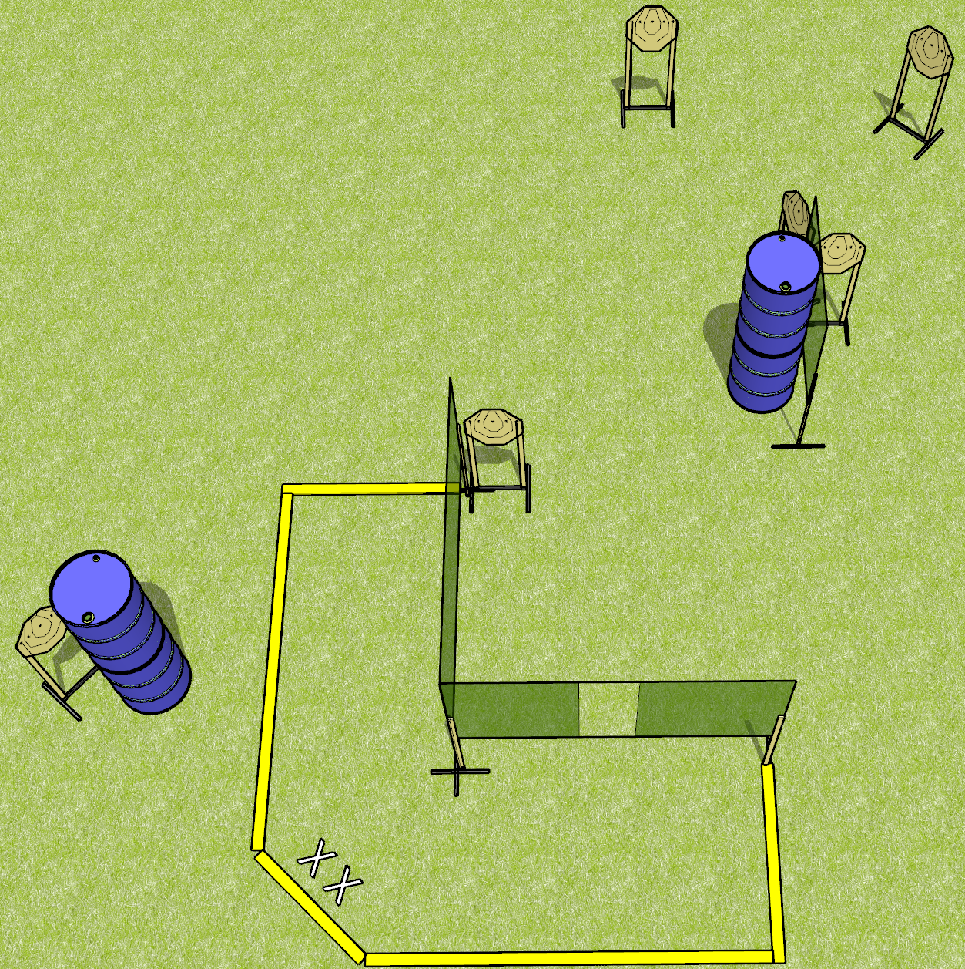
 | Dothan Gun Club – USPSA Match Strong and Weak Course Designer : Drew Coleman
Round Count 24 rounds 6 IPSC targets
Equipment List 5 wall feet 3 medium fault lines 6 targets

Slide 6
Strong and Weak
Written Stage Briefing
Strong and Weak is a 24 round, 120 point, Virginia Count standard exercise. There are 6 IPSC targets. The best 4 hits per target will score. The start signal is audible.
Handgun start position is heels on X’s, wrists below belt. Handgun is loaded and holstered.
PCC start position is heels on X’s, stock on belt. Loaded carbine is held with both hands, safety on.
String 1: on start signal, engage any 3 targets with 2 rounds each from within the shooting area. Perform a mandatory reload and engage the remaining 3 targets with 2 rounds each, strong hand only.
String 1: on start signal, engage any 3 targets with 2 rounds each from within the shooting area. Perform a mandatory reload and engage the remaining 3 targets with 2 rounds each, weak hand only.

Slide 7
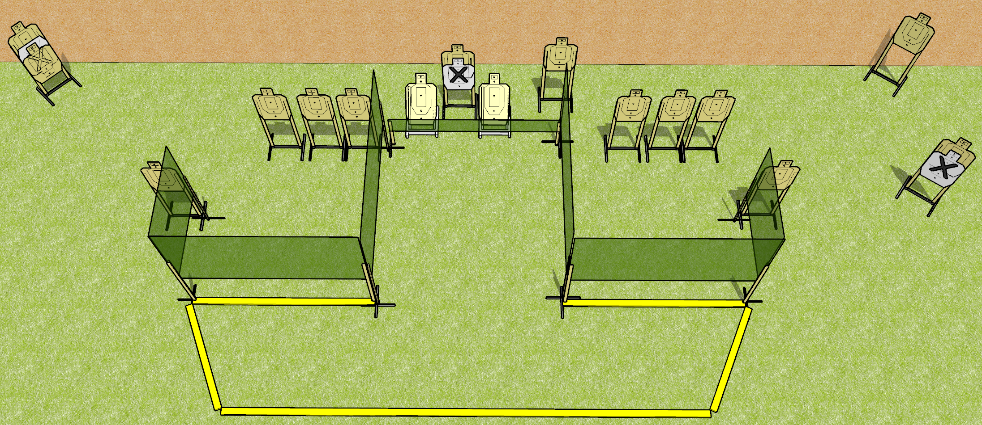
 | Dothan Gun Club – USPSA Match Low Hose Course Designer : Drew Coleman
Round Count 32 rounds 16 USPSA
Equipment List 8 wall feet 19 USPSA targets

Slide 8
Low Hose
Written Stage Briefing
Low Hose is a 32 round, 160 point, Comstock course of fire. There are 16 USPSA targets. The best 2 hits on paper will score. The start signal is audible.
The space under the walls marked by fault lines are ports. No other walls are ports.
Handgun start position is inside the shooting area, wrists below belt. Handgun is loaded and holstered.
PCC start position is inside the shooting area, stock on belt. Loaded carbine is held with both hands, safety on.
On start signal, engage targets as they become available from within the shooting area.

Slide 9
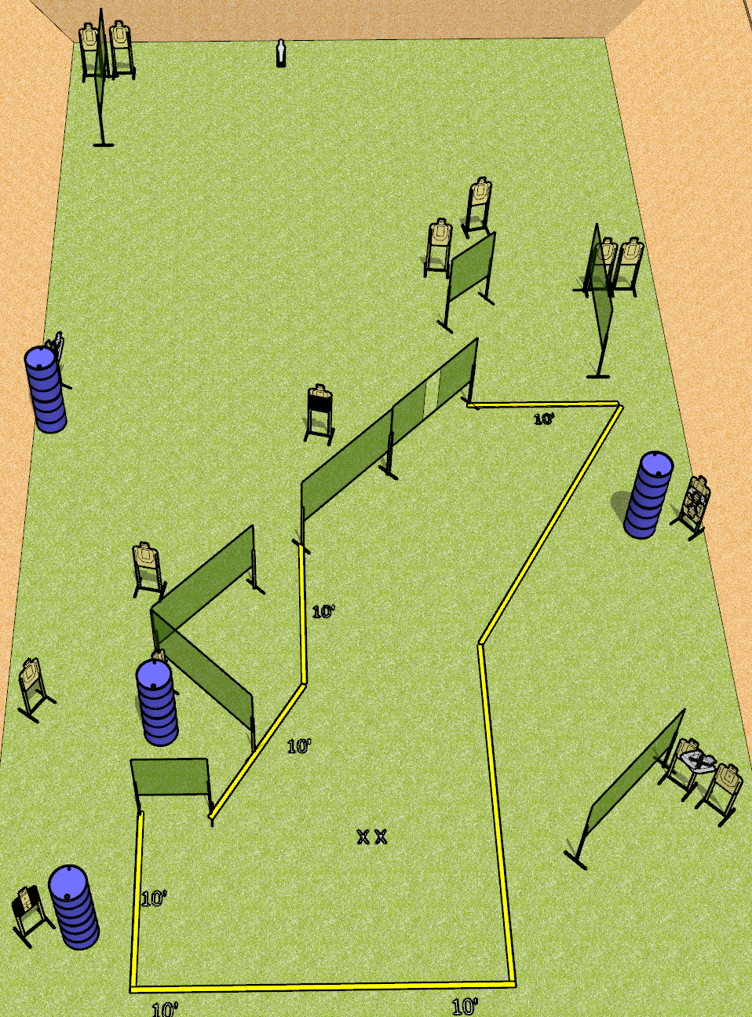
 | Dothan Gun Club – USPSA Match Why Yes, the Entire Bay Course Designer : Drew Coleman
Round Count 33 rounds 16 USPSA 1 mini popper
Equipment List 14 wall feet 1 tux, 1 50%, 17 USPSA (3 NS)

Slide 10
Why Yes, the Entire Bay
Written Stage Briefing
Why Yes, the Entire Bay is a 33 round, 165 point, Comstock course of fire. There are 16 USPSA targets and 1 mini popper. The best 2 hits on paper will score, and steel must fall to score. The start signal is audible.
Handgun start position is feet on X’s, wrists below belt. Handgun is loaded and holstered.
PCC start position is feet on X’s, stock on belt. Loaded carbine is held with both hands, safety on.
On start signal, engage targets as they become available from within the shooting area.

